Slide 1
Unit 4
(STATISTICAL HYPOTHESIS TESTING-
ANOVA, Chi-Square Test, and t-Test)
Statistical tests are used to make decisions or inferences about a population based on sample data. Among the most widely used tests in data science and statistics are t-test, Chi-square test, and ANOVA.

Slide 2
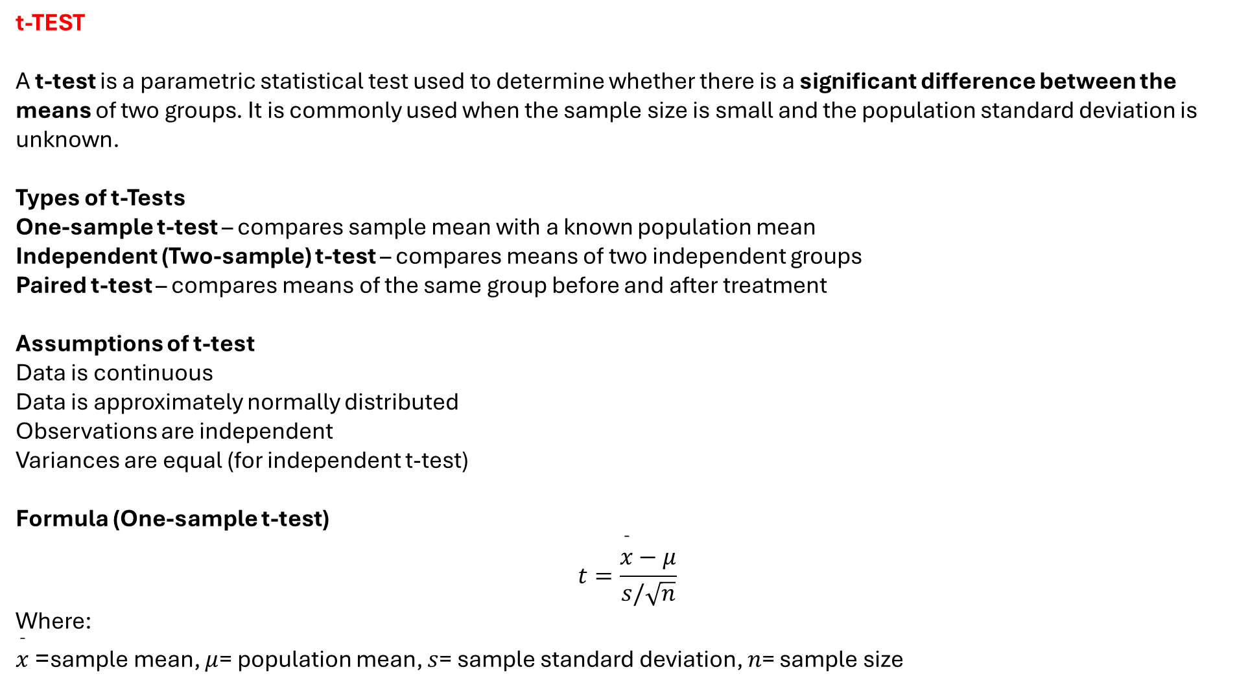
t-TEST
A t-test is a parametric statistical test used to determine whether there is a significant difference between the means of two groups. It is commonly used when the sample size is small and the population standard deviation is unknown.
Types of t-Tests
One-sample t-test – compares sample mean with a known population mean
Independent (Two-sample) t-test – compares means of two independent groups
Paired t-test – compares means of the same group before and after treatment
Assumptions of t-test
Data is continuous
Data is approximately normally distributed
Observations are independent
Variances are equal (for independent t-test)
Formula (One-sample t-test)
$$t=\frac{\overset{ˉ}{x}−μ}{s/\sqrt{n}}$$
Where:
$\overset{ˉ}{x}$= sample mean, $μ$= population mean, $s$= sample standard deviation, $n$= sample size

Slide 3
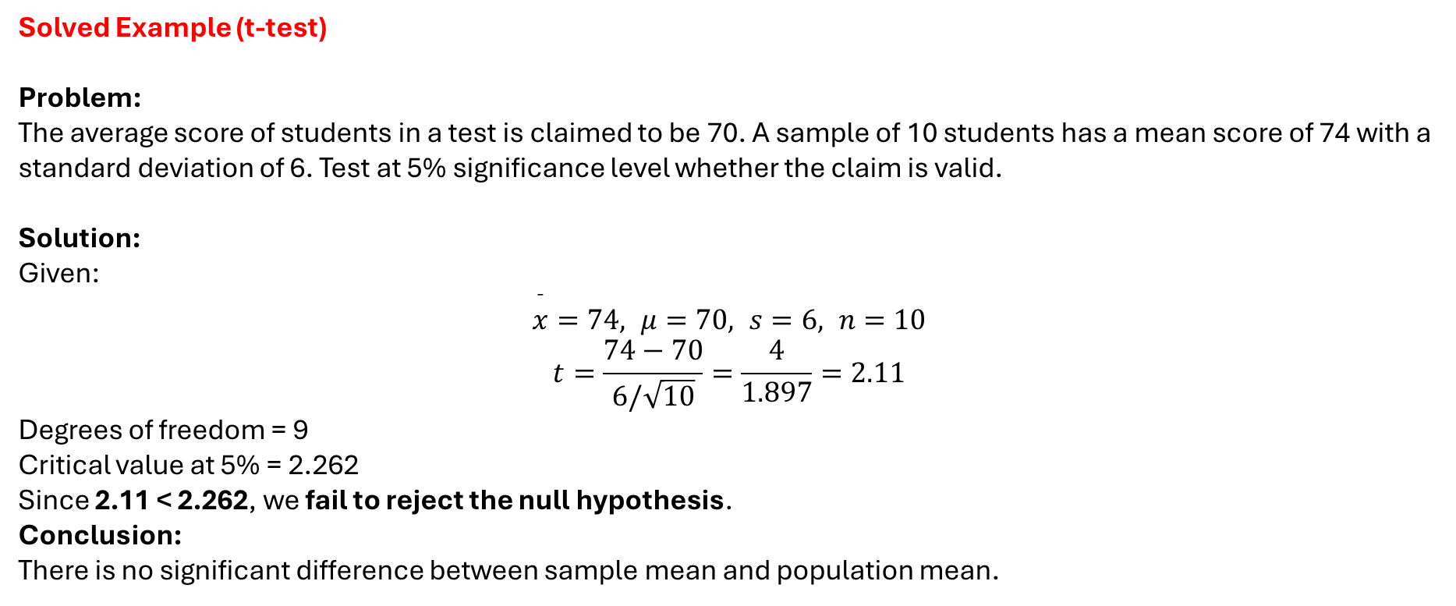
Solved Example (t-test)
Problem: The average score of students in a test is claimed to be 70. A sample of 10 students has a mean score of 74 with a standard deviation of 6. Test at 5% significance level whether the claim is valid.
Solution:
Given:
$$\overset{ˉ}{x}=74, μ=70, s=6, n=10$$
$$t=\frac{74−70}{6/\sqrt{10}}=\frac{4}{1.897}=2.11$$
Degrees of freedom = 9 Critical value at 5% = 2.262
Since 2.11 < 2.262, we fail to reject the null hypothesis.
Conclusion: There is no significant difference between sample mean and population mean.

Slide 4
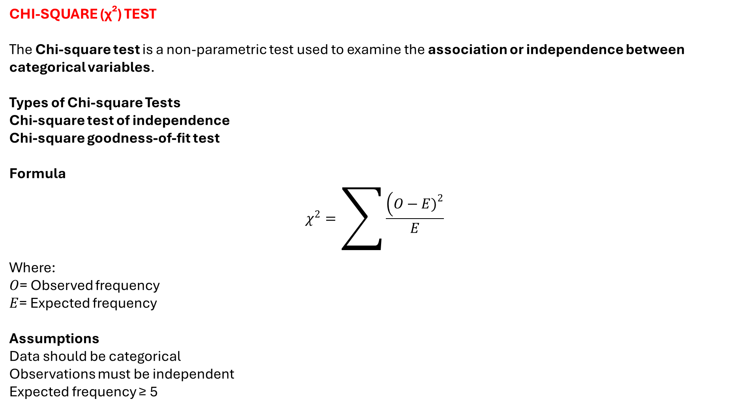
CHI-SQUARE (χ²) TEST
The Chi-square test is a non-parametric test used to examine the association or independence between categorical variables.
Types of Chi-square Tests
Chi-square test of independence
Chi-square goodness-of-fit test
Formula
$$χ^{2}=\sum{\frac{\left(O−E{\left.)\right.}^{2}\right.}{E}}$$
Where:
$O$= Observed frequency
$E$= Expected frequency
Assumptions
Data should be categorical
Observations must be independent
Expected frequency ≥ 5

Slide 5
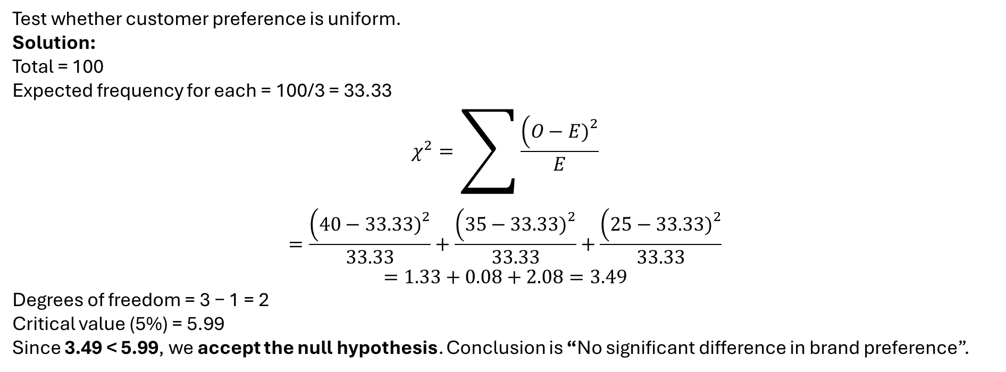
Solved Example (Chi-square Test)
Problem: A survey shows the following preferences for three mobile brands:
Brand | Observed
A | 40
B | 35
C | 25
Test whether customer preference is uniform.
Solution:
Total = 100 Expected frequency for each = 100/3 = 33.33
$$χ^{2}=\sum{\frac{\left(O−E{\left.)\right.}^{2}\right.}{E}}$$
$$=\frac{\left(40−33.33{\left.)\right.}^{2}\right.}{33.33}+\frac{\left(35−33.33{\left.)\right.}^{2}\right.}{33.33}+\frac{\left(25−33.33{\left.)\right.}^{2}\right.}{33.33}$$
$$=1.33+0.08+2.08=3.49$$
Degrees of freedom = 3 − 1 = 2 Critical value (5%) = 5.99
Since 3.49 < 5.99, we accept the null hypothesis. Conclusion is “No significant difference in brand preference”.

Slide 6
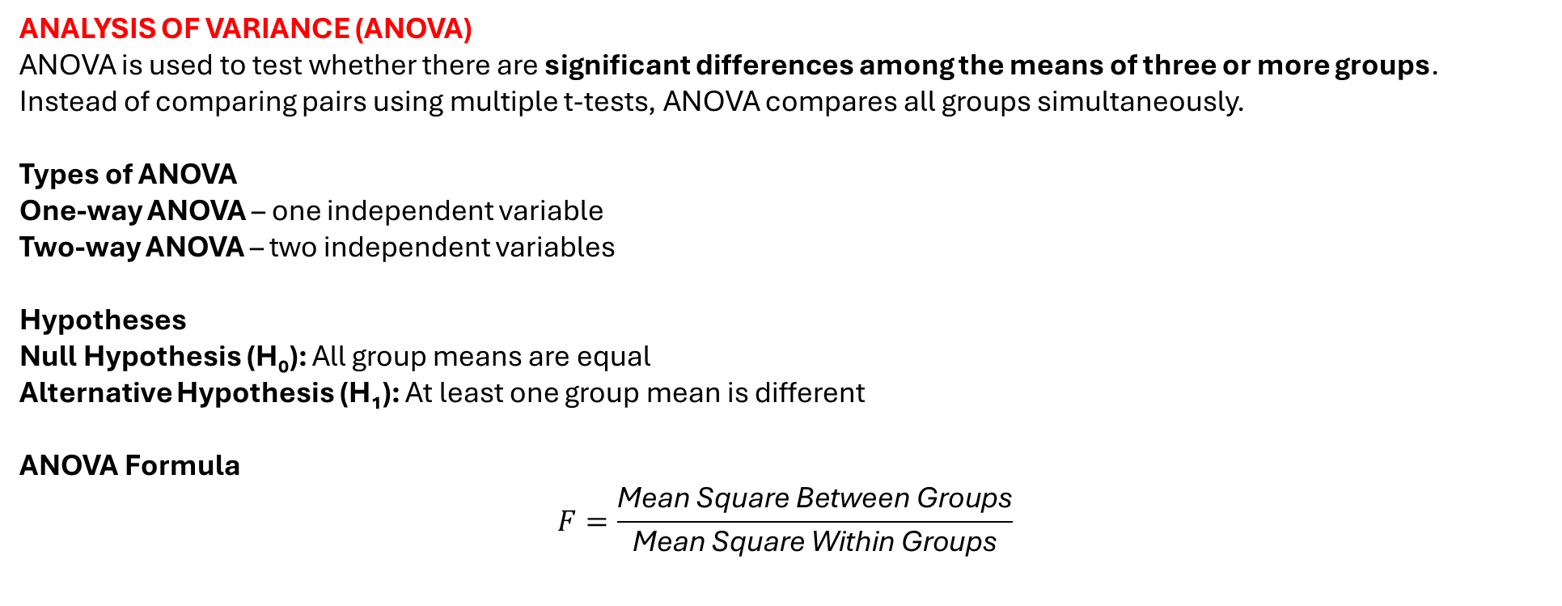
ANALYSIS OF VARIANCE (ANOVA)
ANOVA is used to test whether there are significant differences among the means of three or more groups.
Instead of comparing pairs using multiple t-tests, ANOVA compares all groups simultaneously.
Types of ANOVA
One-way ANOVA – one independent variable
Two-way ANOVA – two independent variables
Hypotheses
Null Hypothesis (H₀): All group means are equal
Alternative Hypothesis (H₁): At least one group mean is different
ANOVA Formula
$$F=\frac{\text{Mean} \text{Square} \text{Between} \text{Groups}}{\text{Mean} \text{Square} \text{Within} \text{Groups}}$$

Slide 7
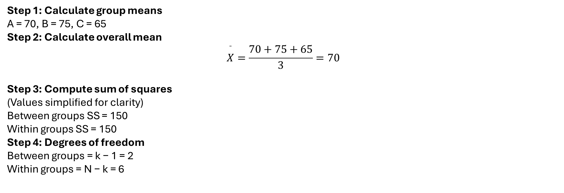
Solved Example (One-Way ANOVA)
Problem: Test whether the mean scores of students taught using three different teaching methods differ significantly.
Group | Scores
A | 65, 70, 75
B | 70, 75, 80
C | 60, 65, 70
Step 1: Calculate group means
A = 70, B = 75, C = 65
Step 2: Calculate overall mean
$$\overset{ˉ}{X}=\frac{70+75+65}{3}=70$$
Step 3: Compute sum of squares
(Values simplified for clarity)
Between groups SS = 150
Within groups SS = 150
Step 4: Degrees of freedom
Between groups = k − 1 = 2
Within groups = N − k = 6

Slide 8
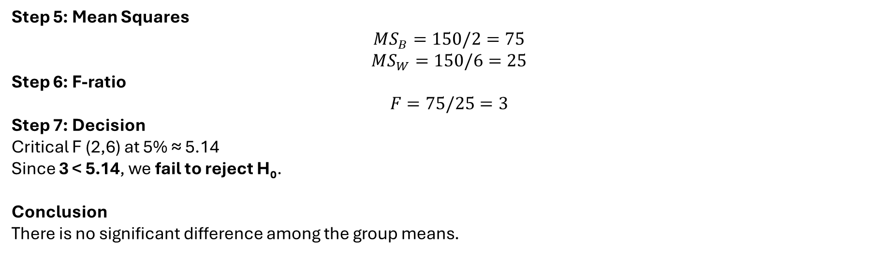
Step 5: Mean Squares
$$MS_{B}=150/2=75$$
$$MS_{W}=150/6=25$$
Step 6: F-ratio
$$F=75/25=3$$
Step 7: Decision
Critical F (2,6) at 5% ≈ 5.14
Since 3 < 5.14, we fail to reject H₀.
Conclusion
There is no significant difference among the group means.

Slide 9
TWO-WAY ANOVA (Analysis of Variance)
Two-way ANOVA is a statistical technique used to examine the effect of two independent variables (factors) on a single dependent variable. It also helps determine whether there is an interaction effect between the two factors.
Unlike one-way ANOVA, which tests only one factor, two-way ANOVA analyzes:
The effect of Factor A
The effect of Factor B
The interaction effect (A × B)
Applications of Two-Way ANOVA
Studying the effect of teaching method and gender on student performance
Analyzing fertilizer type and irrigation level on crop yield
Evaluating training method and experience level on employee productivity
Assumptions of Two-Way ANOVA
Observations are independent
Data is normally distributed
Homogeneity of variances
Equal sample sizes (preferred)

Slide 10
Hypotheses in Two-Way ANOVA
Let:
Factor A → Teaching Method
Factor B → Study Time
Null Hypotheses:
H₀₁: No significant effect of Factor A
H₀₂: No significant effect of Factor B
H₀₃: No interaction effect between A and B
Two-Way ANOVA Table Format
Source of Variation | Sum of Squares | df | Mean Square | F-ratio
Factor A | SSA | a−1 | MSA | MSA / MSE
Factor B | SSB | b−1 | MSB | MSB / MSE
Interaction (A×B) | SSAB | (a−1)(b−1) | MSAB | MSAB / MSE
Error | SSE | ab(n−1) | MSE | —
Total | SST | abn−1 | — | —

Slide 11

Solved Example – Two-Way ANOVA
Problem Statement
The following table shows marks obtained by students using two teaching methods (A and B) and two study durations (Short and Long). Perform a two-way ANOVA at 5% level of significance.
Teaching Method | Short Study | Long Study
A | 70 | 80
B | 65 | 75
Step 1: Define Factors
Factor A: Teaching Method (A, B)
Factor B: Study Duration (Short, Long)
Step 2: Compute Grand Mean
$$\text{Grand} \text{Mean}=\frac{70+80+65+75}{4}=72.5$$

Slide 12
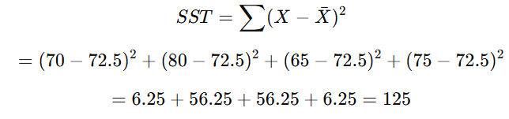
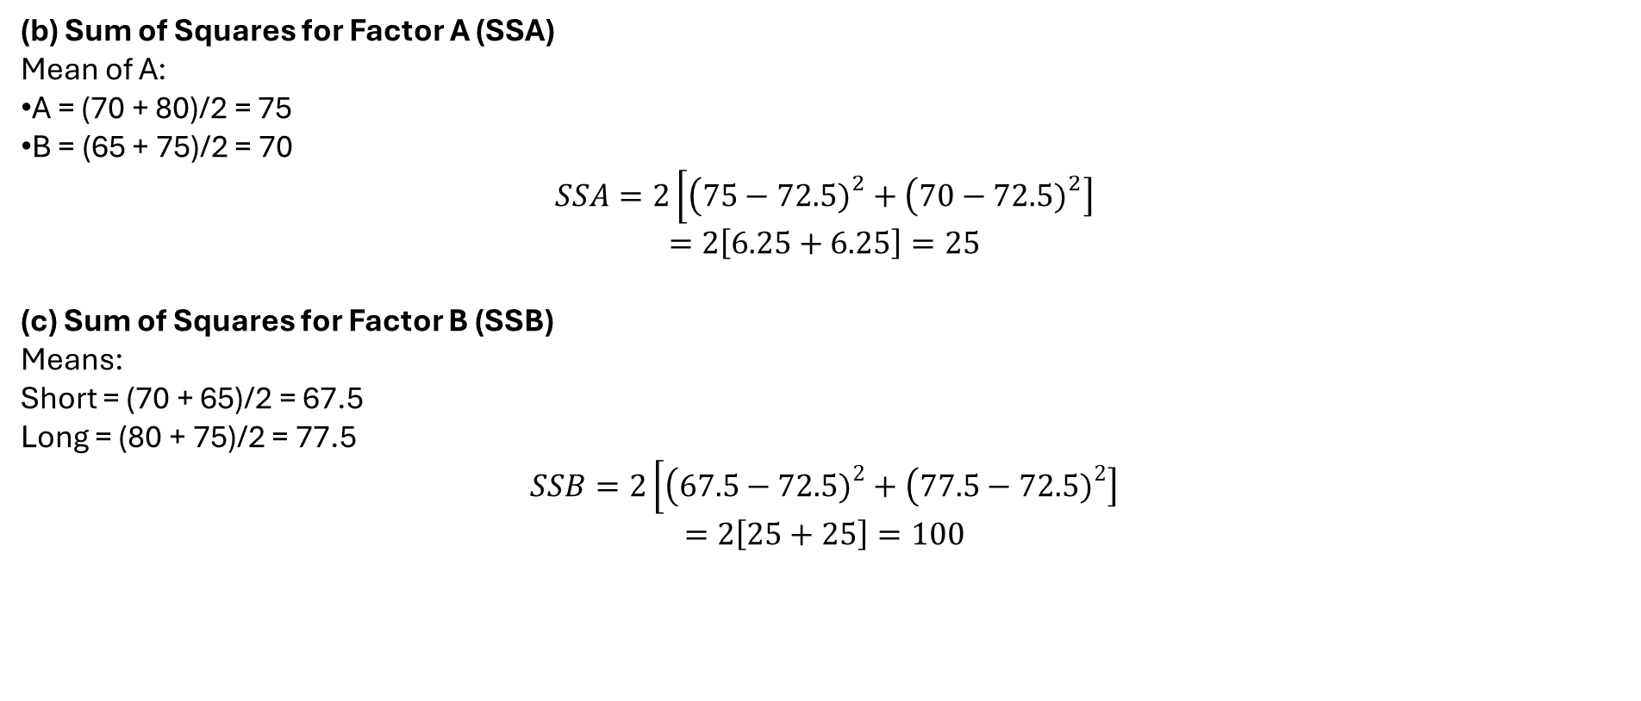
Step 3: Compute Sum of Squares
(a) Total Sum of Squares (SST)
(b) Sum of Squares for Factor A (SSA)
Mean of A:
A = (70 + 80)/2 = 75
B = (65 + 75)/2 = 70
$$SSA=2\left[\left(75−72.5{\left.)\right.}^{2}+\left(70−72.5{\left.)\right.}^{2}\right]\right.\right.$$
$$=2\left[6.25+6.25\right]=25$$
(c) Sum of Squares for Factor B (SSB)
Means:
Short = (70 + 65)/2 = 67.5
Long = (80 + 75)/2 = 77.5
$$SSB=2\left[\left(67.5−72.5{\left.)\right.}^{2}+\left(77.5−72.5{\left.)\right.}^{2}\right]\right.\right.$$
$$=2\left[25+25\right]=100$$

Slide 13
(d) Interaction Sum of Squares (SSAB)
$$SSAB=SST−SSA−SSB$$
$$=125−25−100=0$$
Step 4: Degrees of Freedom
Source | df
Factor A | 1
Factor B | 1
Interaction | 1
Error | 0
Total | 3
(Since this is a simplified example with one observation per cell, error term is zero)

Slide 14
Step 5: ANOVA Table
Source | SS | df | MS | F
Factor A | 25 | 1 | 25 | —
Factor B | 100 | 1 | 100 | —
Interaction | 0 | 1 | 0 | —
Error | 0 | 0 | — | —
Total | 125 | 3 | — | —
Interpretation
Factor A (Teaching Method) has an effect on performance.
Factor B (Study Duration) has a stronger effect.
No interaction effect between teaching method and study duration.
Two-way ANOVA helps in understanding:
Individual effects of two factors
Combined interaction effect
Better decision-making in experiments involving multiple variables

